Slide 1
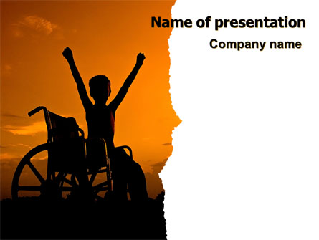
SAKSHAM AN ANDROID APPLICATION FOR DISABLED
by
Ankita Bajantri
Durgesh Nandan
Nikita Bhavi
Prachi Khandke

Slide 2
The worst thing about a disability is that people see it before they see you
by Easter Seals

Slide 3
INDEX
PROBLEM UNDERSTANDING
INTRODUCTION
LITERATURE SURVEY
OVERALL DESIGN
ARCHITECTURE
TECHNOLOGY TO BE USED
DEPENDENCIES

Slide 4
STATISTICS
1.37 B
12.6 M
>26%
2.1%
26%
Population of India 2019 est.
People with Disability
Count
Use Smartphones
Our Goal
Data Provided by most recent CENSUS

Slide 5
PROBLEM UNDERSTANDING
From time immemorial, man has been struggling against the ravages wrought by disease, accident or feud. The problem of the physically handicapped is, therefore, as old as human life itself. Problems of the physically handicapped vary in time and space. Their problems are multi-dimensional physical, psychological, social, cultural, educational and vocational. Each category of disability poses a different set of problems.
Problem of Physical Mobility
Problem of Reading and Communication
Lack of job-oriented training facilities

Slide 6
Intro duction
A word like handicapped once was used very widely, but now would generally be considered to be not appropriate to use,"
- Dr. Laugesen
People with disabilities are one of the most marginalized and excluded groups in society. Facing daily discrimination in the form of negative attitudes, lack of adequate policies and legislation, they are effectively barred from realizing their rights to healthcare, education, and even survival.
Saksham is an open-source smartphone Android app. It connects the vernacular audience, disabled to be precise with users of the same kind or normal citizens.

Slide 7
Literature Survey
Hand-to-Hand Instant Message Communication: Revisiting Morse Code by Sujay Pawar. https://www.academia.edu/26952487/Hand_to_Hand_Instant_Message_Communication_Revisiting_Morse_Code.
Disability and assisstive technology: Omer Faruk Islim,Kursat Cagiltay, Middle East Technical University, Turkey.
Thimbleby, H.: Understanding User Centred Design (UCD) for People with SpecialNeeds, 1611–3349 (2008)26. Henry, S.: Just ask: integrating accessibility throughout design. [United States]:Lulu.com (2007).
https://developer.android.com/docs (Android Documentation)

Slide 8
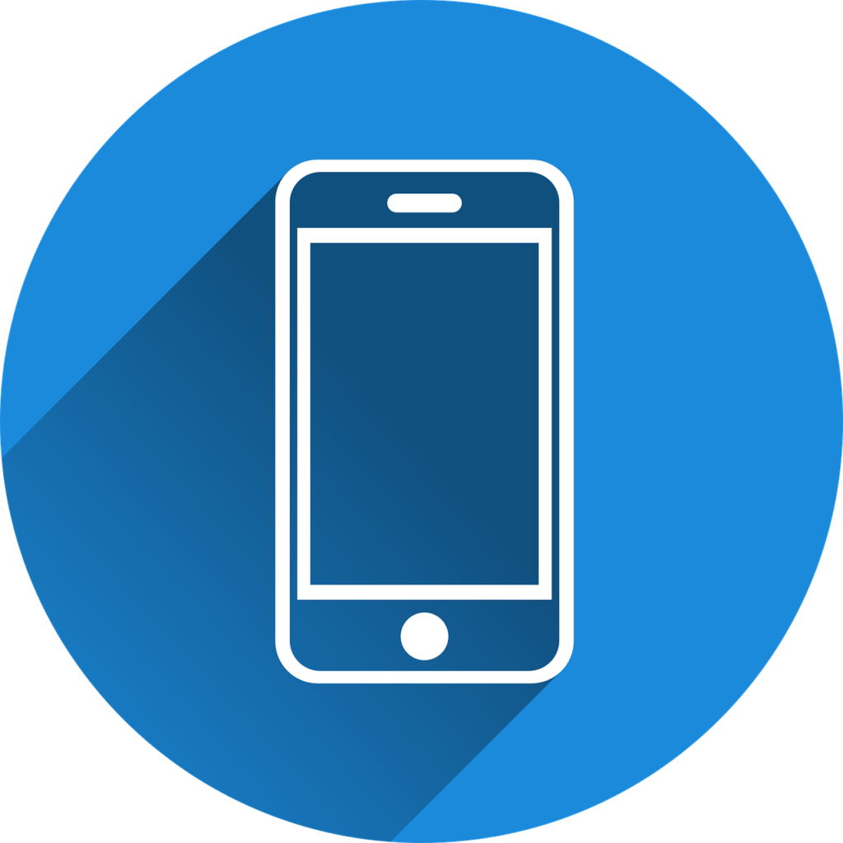
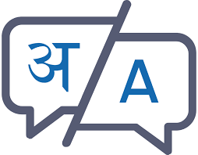

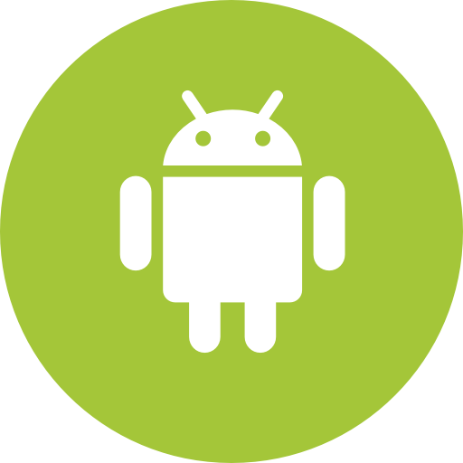
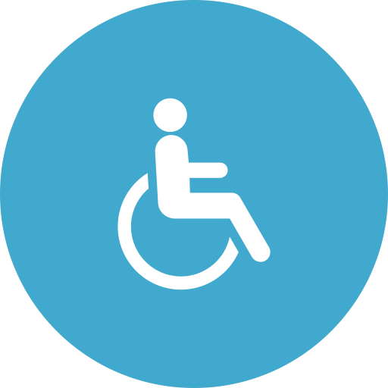
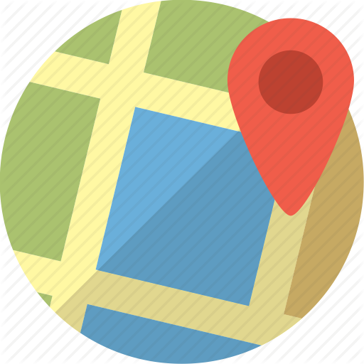
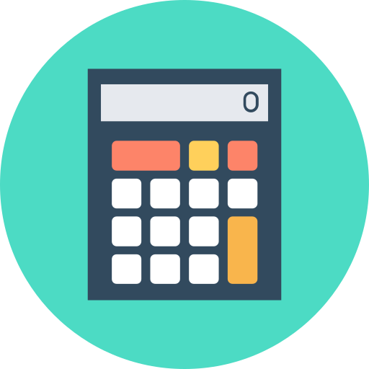
Overall Design
make and receive calls, identify caller
Support for regional languages
write and read text messages
Saksham Application
User
GPS Pathfinder
Calculator and Unit Converter

Slide 9
Overall Design
Make and receive calls.
Write and read SMS.(Morse Code or Speech Recognition and Gestures)
Identify the phone number of an incoming call before you answer.
Read rich text as audio-book using text-to-speech with support of several regional languages.
GPS Navigator to guide the route.
Calculator using the Natural Language Processing (NLP) along with Unit Converter.

Slide 10
Technology Stack (Architecture)
JAVA
Backend
JSON
NoSQL
on Cloud
Stacking the app into a single package apk
Build
App
DB
Cloud based on NoSQL/JSON/XML
Models for Database
Gradle
XML
Android Build Tool
Frontend

Slide 11
Technology to be used
Android
Android
Full Stack Android Development comprising of Android Studio, Postman, Hibernate, and Service APIs and several SDKs.
NLP
Natural Language Processing
This app makes use of Natural Language Processing in Speech-To-Text and Text-To-Speech recognition.
Cloud(JSON/NoSQL)
Cloud(JSON/XML/NoSQL)
Cloud is being used as a database in which traditional, structured data is not followed instead it makes use of JSON, NoSQL or XML.
Java/XML
Java/XML
Java is used for back-end and XML is used for front-end.

Slide 12
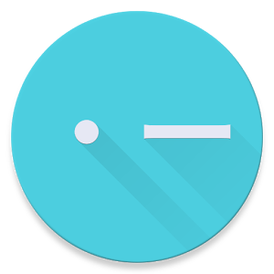

Dependencies
Morse Code
Users should be aware of Morse code to use this app
Internet Connection
Stable Internet connection is required.
Android API level 19
Minimum Version on which App runs: KitKat and later versions.

Slide 13

Thank You

